Slide 1
Welcome to Virtual Learning
EPSS
Years 3 – 6, 2020.

Slide 2
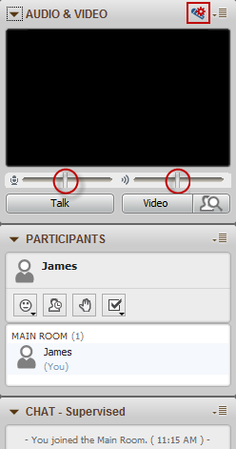
Audio Testing: locate the control panel at the top left hand corner of your virtual classroom:
Select the microphone icon in the Audio and Video panel
Next, select the correct headset from the drop down list (below)
If your headset does not appear, select Refresh

Slide 3
Audio Testing continued:
Adjust the microphone and speaker sliders.
Adjust speaker volume.
Turn mute off.

Slide 4
Click the Talk button to turn your microphone on and off.
The microphone icon near your name indicates your microphone is on.

Slide 5
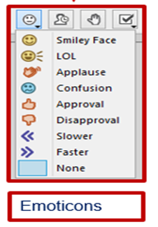

Slide 6
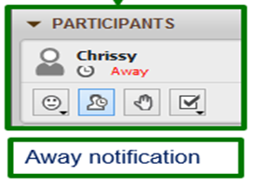

Slide 7
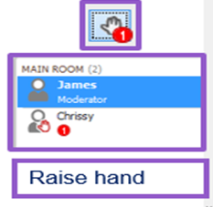

Slide 8
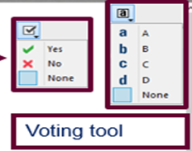

Slide 9
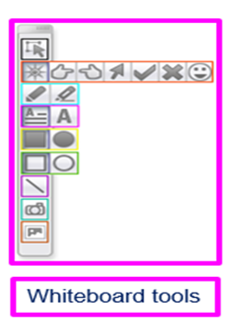

Slide 10
Laser pointer activity
Notes:
Activity
Have them number off using the “Raise Hand’ tool – leave your hand up.
Demonstrate how to use the Laser pointer.
Ask participants to select the second icon down to expand the menu.
Select a pointer of choice.
Go to their corresponding number on the whiteboard screen.
Hold left mouse down and circle your number.

Slide 11
Clip art activity
Notes:
Activity
ClipArt tool – last icon.
Go to Common Symbols and choose an icon and fill out the squares.
Use the selector tool to resize the icons to fill the square.
Using the selector tool delete your icons.

Slide 12
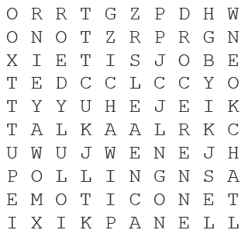
Highlighter activity
Audio
Chat
Emoticon
OneChannel
Panel
Polling
Record
Selector
Talk
Notes:
Activity
Using the highlighter tool, find the words in the grid.
It doesn't matter if they are highlighting more than once, use different colours

Slide 13
Shape fill activity
1
4
6
10
9
7
5
10
1
11
3
2
8
12
11
3
4
7
9
12
5
8
2
6
Notes:
Activity
Leave hand up.
Demonstrate.
Using the Fill shape tool – fill over your number
Click on object then change the colour.
HANDS DOWN after this activity…
.

Slide 14
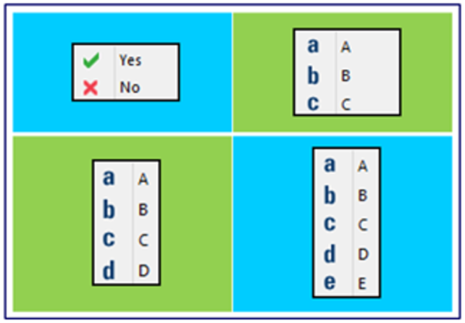
Polling activity
What is your favourite colour?
True or False … web conferencing is delivered through Skype?
Which flag belongs to the country you’d most like to visit?
Notes:
Activity
Polling
How to use the polling tool to participate in a poll.
Ask each question in turn. Change the polling options.
Publish results but don’t need to explain how to do this in this activity – we covert this in the moderator sessions.

Slide 15
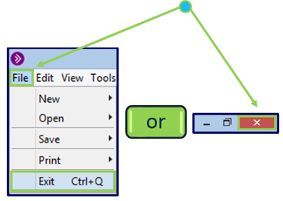
Thank you for your participation
Please exit the session …
Notes:
Tasks:
Ensure all participants/moderators have left the room so the recording can be processed.
Ensure you have saved the Participants List and Chat if required: File > Save > Chat …. File > Save > Participants List…
Script suggestion:
Please exit the session.
If you have any questions or need assistance please let me know via the chat window.

